Slide 1
The Mutual Fund Industry in India
Data Visualization project on
Made by – Prachi Chavan

Slide 2
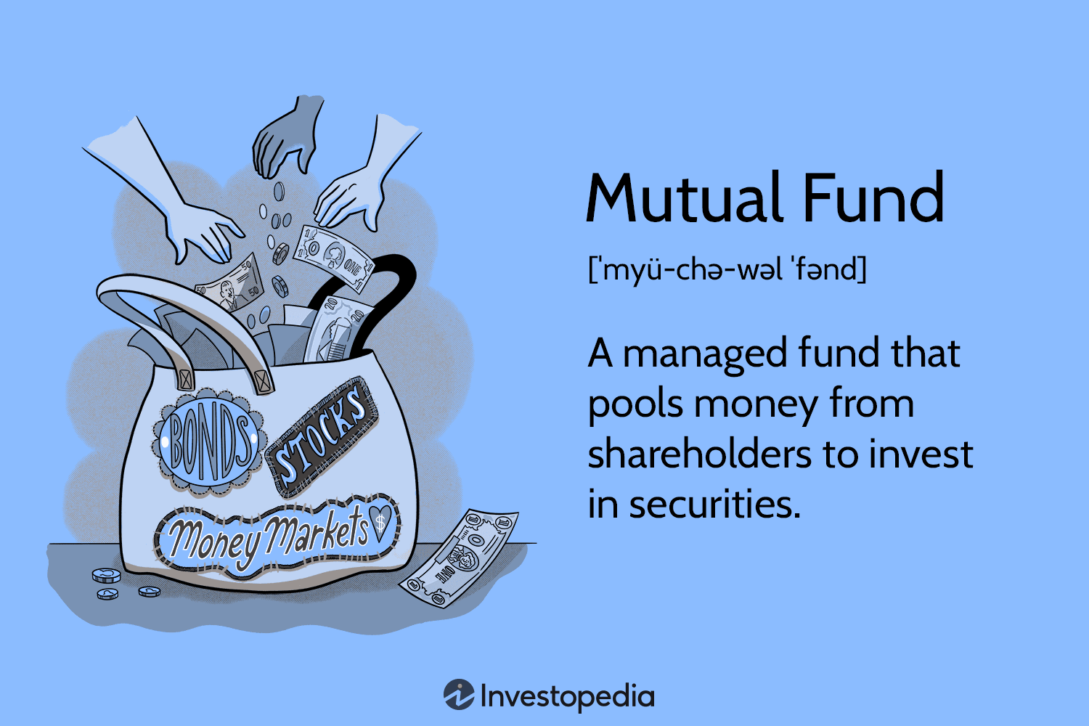
What are Mutual Funds?
A mutual fund is a pool of money managed by a professional Fund Manager. It is a trust that collects money from a number of investors who share a common investment objective and invests the same in equities, bonds, money market instruments and/or other securities

Slide 3
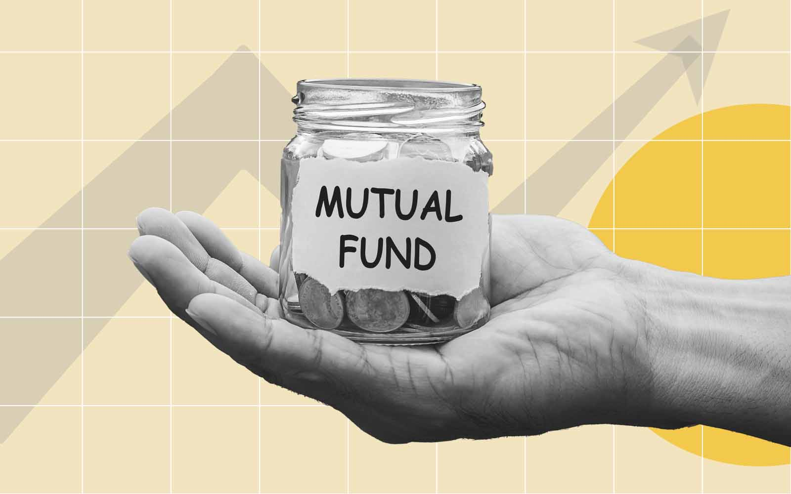
Executive Summary
1

Slide 4
This project aims to develop interactive and insightful dashboards using Tableau/Power BI for gaining a better understanding of the Mutual Fund Industry in India.
This can help us to enhance data-driven decision-making like which Mutual Fund houses are the best and most trusted and which schemes are the most popular.
The dashboards will focus on key performance indicators(KPIs), providing a visual representation of critical business metrics of the Mutual Fund Market in India.

Slide 5

Problem Statement
2

Slide 6
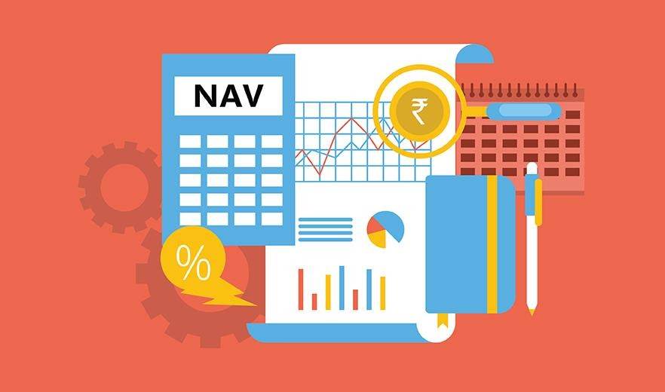
Background
Limited understanding of large datasets and understanding all the different performance metrics hinders
decision-making skills of most individuals.

Slide 7





Objective
Scope
Develop dashboards to get a better understanding of the Mutual Fund Industry in India and analyze the data to gain better understanding of it using Data Visualization. Also help individuals make better informed decisions as per their requirements
Initial focus on the various Mutual Fund houses in India, the various schemes provided by them and to what categories they belong to. Also analysis based on the NAV(Net Asset Value) and the risk factors of each scheme as well as their ratings

Slide 8
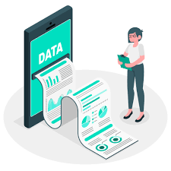
Data Sources
3

Slide 9

External data sources for Mutual Funds in India, detailed information about the industry as well as rating and risk factors of them.
The data used in this project is secondary data which is collected from Kaggle.
Multiple data from various Kaggle datasets is collected and combined for better report generation.

Slide 10

Methodology
4

Slide 11
Data Integration
Dashboard Design
Interactivity
Extract and integrate data from various sources into Tableau/Power BI.
Also combining the datasets using SQL
Collaborate with stakeholders to identify key metrics and design visually appealing dashboards that aren’t very cluttered to make it easier to understand and are less complex.
Implement interactive features for drill-down analysis and trend exploration
Create parameters the filter out the unnecessary data as per user’s requirements

Slide 12
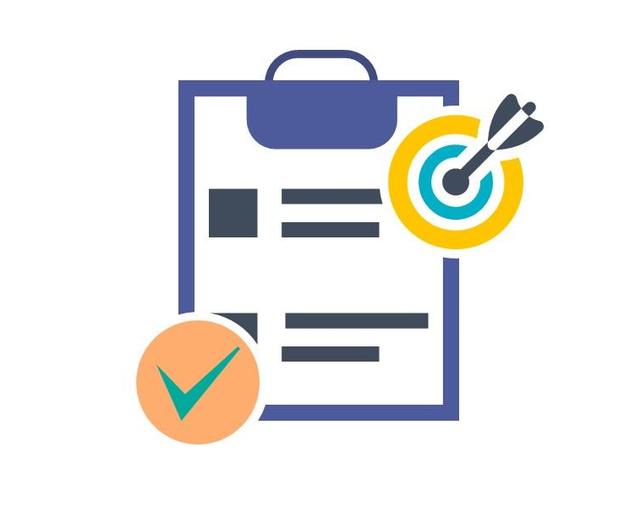
Expected Outcomes
5

Slide 13
Interactive dashboards that provide insights into the Mutual Fund Industry in India.
Enhanced decision-making through visual representation of key metrics.
Easily able to filter out the data that does not fit the individual user’s requirements and make this process user-friendly.

Slide 14



Tools and Technologies:
6
Tableau/Power BI for dashboard development
Excel for data management
SQL for merging datasets.
Collaboration tools for stakeholder feedback

Slide 15

Risks and Challenges :
7
Integration challenges may arise while connecting to diverse data sources
Ensuring data accuracy and consistency across dashboards
To make sure no data is lost while combining all datasets
Handling such large datasets might take time to load and could cause the software to crash
User adoption and training challenges for stakeholders unfamiliar with Tableau/Power BI

Slide 16

Conclusion
8

Slide 17
This project is made to help individuals make better decisions while investing in Mutual Funds as per their own risk appetite and also the ratings provided for each schemes to make informed decisions. The dashboards/reports created using the Visualization tool gives us a better understanding of the Mutual Fund Industry in India

Slide 18

This project is made to help individuals make better decisions while investing in Mutual Funds as per their own risk appetite and also the ratings provided for each schemes to make informed decisions. The dashboards/reports created using the Visualization tool gives us a better understanding of the Mutual Fund Industry in India

